Slide 1

Audits, Assessments, & Consulting: Navigating the Frontlines of Cybersecurity and Compliance
September 2025

Slide 2
Poll Question #1
What’s your organizational role?
IT Audit
Governance / Risk / Compliance
Security Operations
IT Administration
Other
Notes:
Poll #1
Results as a bar graph please

Slide 3
Poll Question #2
How long have you been doing it?
1-3 years
4-8 years
9-15 years
Too long…
Notes:
Poll #2
Results as a bar graph please

Slide 4

Who am I?
Identity Paradox
How do you know (I’m not a deep-fake)?

Slide 5
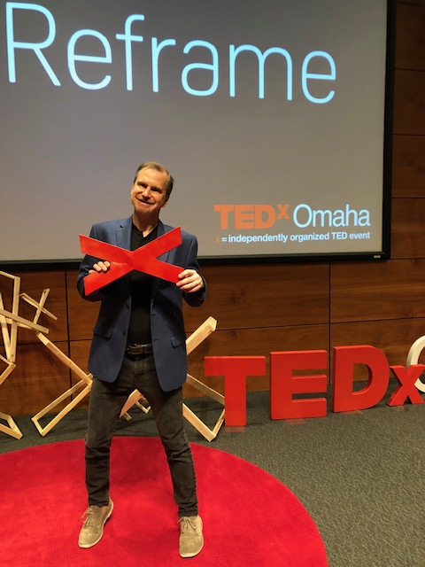

>whoami
Ron Woerner
Hacker
Cybersecurity Consultant / Trusted Advisor
Professor, Bellevue University
25+ years experience in IT / Security
Blogger, writer, and podcaster
TEDx Omaha, 2019, Hackers Wanted
LinkedIn: https://www.linkedin.com/in/ronwoerner/
Websites & Social Media: https://linktr.ee/cyberron

Slide 6
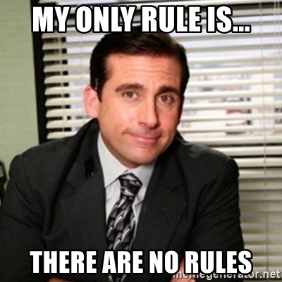

Thoughts are
my own
Use at your own risk
Please Ask Questions

Slide 7
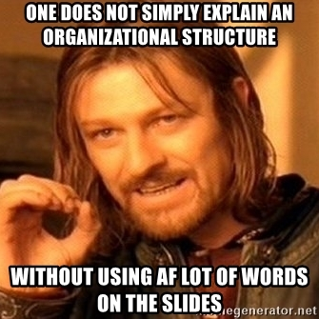
What the
$%$# are we doing here?

Slide 8
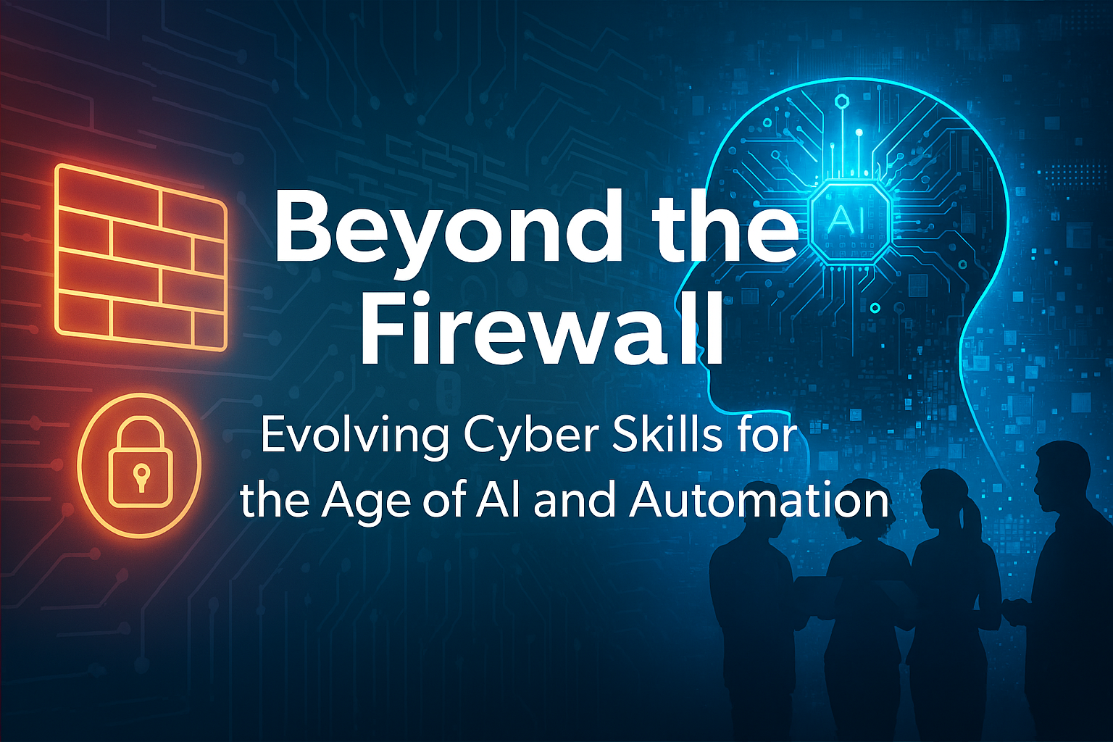
Learning objectives:
Recognize the Consultant’s Role – Gain insights into the responsibilities, challenges, and opportunities consultants face when advising organizations.
Understand the Audit & Assessment Lifecycle – Learn how consultants plan, scope, execute, and report on audits and assessments across compliance, privacy, and security domains.
Develop Essential Skills for Success – Explore the mix of technical expertise, business acumen, communication, and relationship-building needed to thrive as a consultant.
Bridge Frameworks to Real-World Practice – See how standards, regulations, and risk frameworks are applied in practice to improve governance and strengthen organizational resilience.
Exploring the strategic and practical dimensions of AI in cybersecurity.
Notes:
Audits and assessments are critical for identifying risks, evaluating controls, and ensuring compliance—but their impact goes far beyond checklists and reports. This session explores the real-world experience of being a consultant in the audit and assessment space, where technical knowledge must be balanced with communication, adaptability, and client trust. Attendees will gain an inside look at the lifecycle of an engagement, from planning and scoping to reporting and remediation, while also learning the practical skills that make consultants successful. Through real-world examples, the session highlights both the challenges and rewards of advising organizations on governance, risk, and compliance. Whether you are considering consulting as a career path or seeking to better understand the role of external advisors, this session provides a candid perspective on the realities of the field.

Slide 9
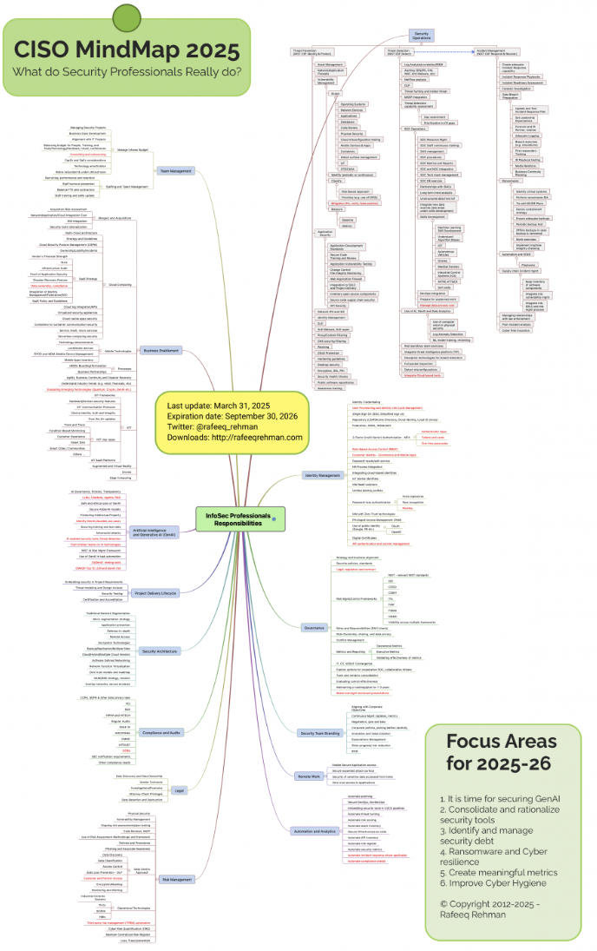
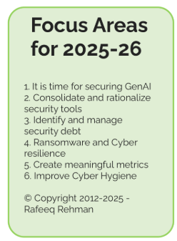
Life of a cybersecurity consultant
Source: https://rafeeqrehman.com/2025/03/30/ciso-mindmap-2025-what-do-infosec-professionals-really-do/

Slide 10
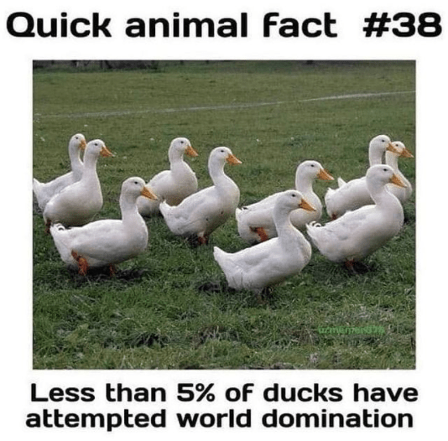
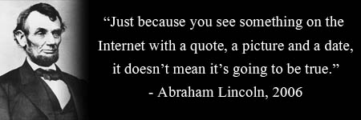
Cybersecurity (& AI) Core Principle
Trust, AND Verify
“Never trust a single data point.”
from my life as a military intelligence officer
NOT AI generated

Slide 11
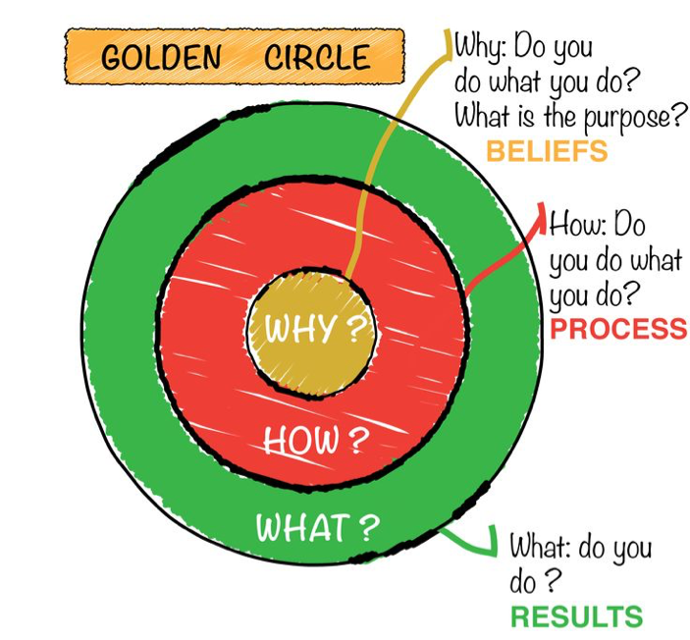
Root Cause – Start with “Why”
What problem are you solving?
https://startwithwhy.com/

Slide 12
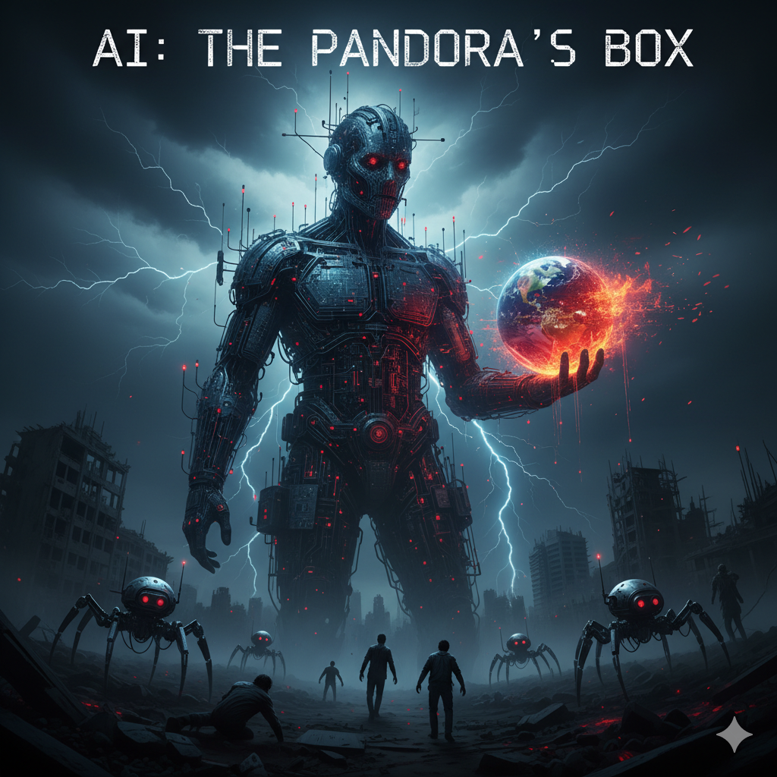
Philosophical Reflection
To AI or not to AI, That is the Question…
How/when/where/why do you use AI?
AI generated image

Slide 13
Philosophical Reflection
To AI or not to AI, That is the Question…
How do you know what’s “true” and verify results?
How do you define and measure “trust”?
Explore ethical dilemmas
What bias may be introduced?
Over-reliance on machines*
Balancing automation with human involvement
Embracing continuous learning and interdisciplinary fluency
NIST AI Risk Management Framework
AI Risks & Trustworthiness
Valid and Reliable
Safe
Secure and Resilient
Accountable and Transparent
Explainable and Interpretable
Privacy-Enhanced
Fair – with Harmful Bias Managed

Slide 14
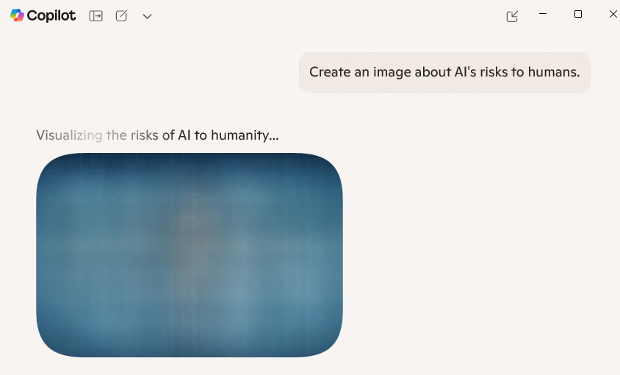
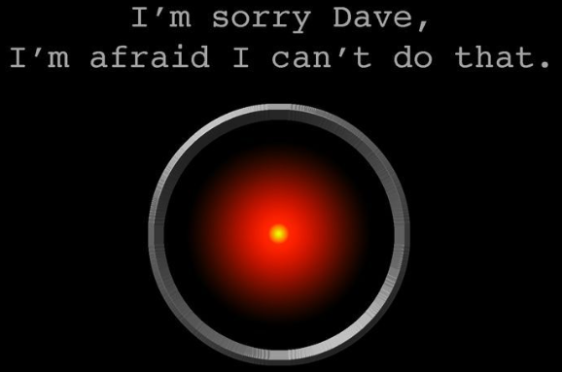
AI Human Risks
* This isn’t true. Trust & Verify.

Slide 15
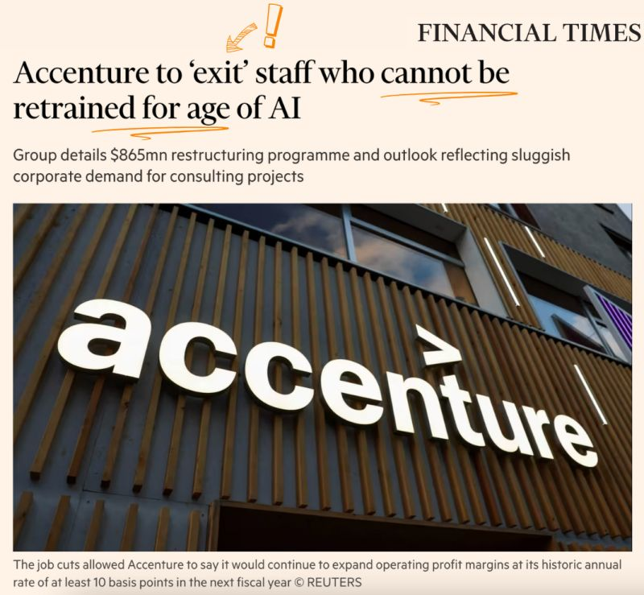
AI Human Risks
AI generated image
https://www.ft.com/content/a74f8564-ed5a-42e9-8fb3-d2bddb2b8675
Notes:
40 years ago – Age of PC
30 years ago – Internet
15 years ago – Cloud & mobile
Today – AI
--------------------------
Will AI rot our brains?
Will AI waste our time (instead of save it)?

Slide 16

What You Can (Should) Do
Only You Can Protect Yourself and Others
Embrace Continuous Learning
Secure by Design / Build Security In
Adversarial Techniques
Zero Trust
Threat Modeling

Slide 17
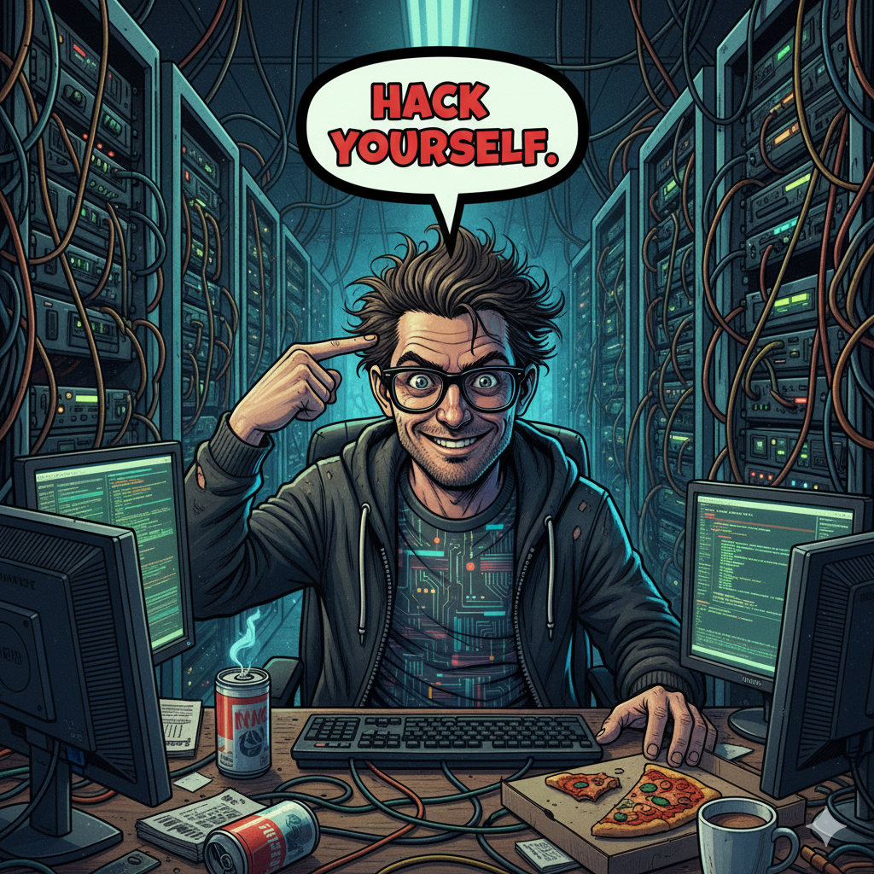
Building Skills: Experiment
Ethically & safely. Set up a home lab.
Learn through doing
Ask questions
Sun Tzu's The Art of War: "Know the enemy and know yourself; in a hundred battles you will never be in peril.“
AI generated image

Slide 18
Mastering Fundamentals
Cybersecurity:
Computer Science, Math, Economics, Marketing, Psychology
GRC
Design Principles / Zero Trust
Threat Modeling
AI:
SDLC / Coding Best Practices
Core Algorithms: Decision trees, neural networks, clustering
Prompt Engineering
Understanding the “why” behind the model helps you spot challenges and design more resilient systems.

Slide 19
AI Terms & Definitions
Reference*: https://iapp.org/resources/article/key-terms-for-ai-governance/
LLM (Large Language Model): A type of deep learning model trained on massive text datasets to understand and generate human-like language.
Core Use: Text generation, summarization, translation, coding assistance
Examples: GPT-4, Claude, Gemini, LLaMA
NLP (Natural Language Processing): An AI subfield that enables machines to understand, interpret, and generate human language.
Core Use: Text classification, entity recognition, translation, summarization
Examples: Siri, Alexa, ChatGPT, Google Translate
Multimodal Models: AI systems capable of processing and integrating information from multiple types of data — or “modalities” — such as text, images, audio, video, and sensor input.
GenAI (Generative AI): Models that create new content — text, images, audio, code — based on learned patterns from training data.
Agentic AI: Autonomous systems that can set goals, plan, and execute tasks with minimal human intervention. These systems use LLMs as a “brain” and orchestrate multiple agents to complete complex workflows.
Prompt: A question, instruction, or input given to an AI model to guide its response.
Vibe Coding: an emerging development style where programmers use natural language to guide AI tools in generating code.
Core Use: Fast prototyping, solo app development, creative coding
Tools: Replit, Cursor, GitHub Copilot

Slide 20
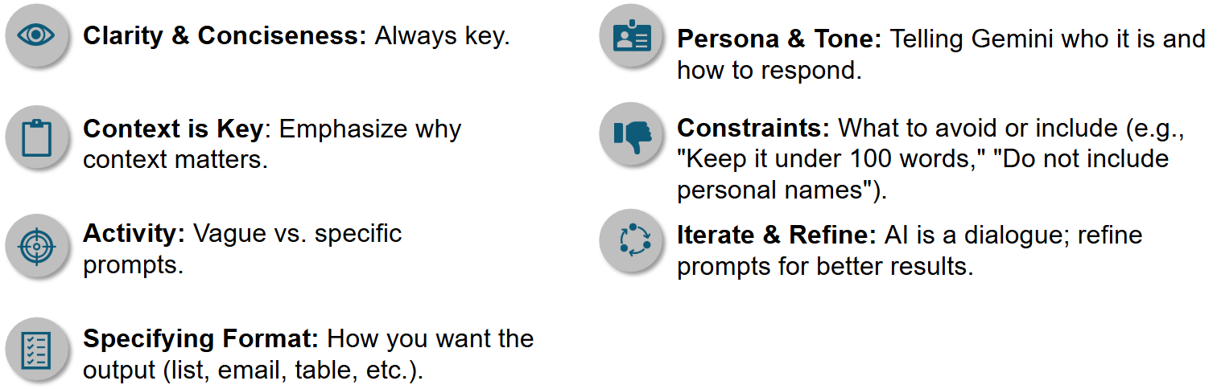
AI Conversations: Prompting Fundamentals
Asking good questions
What are your prompting tips?
Notes:
How to “talk” to AI* - Key Principles of Effective Prompting:

Slide 21
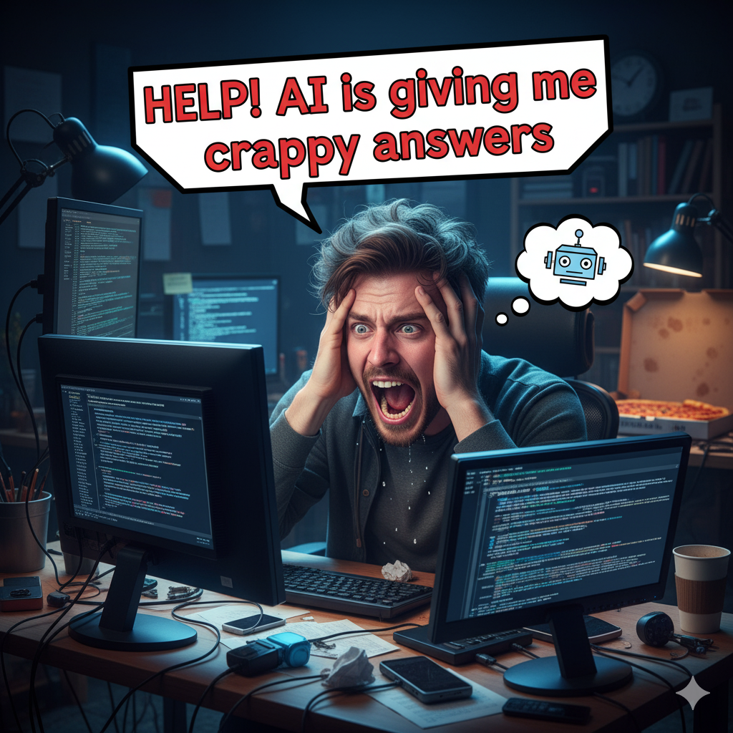
1. Prompt fundamentals
2. Ask it:
“Be direct, objective, expose blind spots, challenge assumptions”
Play “Devil’s Advocate.” Critique ideas from multiple personas & angles
For credible citations and flag weak evidence - Include source links
Show its work / “thought process”
For clarity and conciseness
3. Start over. Try a different tact
AI generated image

Slide 22
Core AI Competencies for Cyber Professionals
Technical Skills to Cultivate:
AI Fundamentals: Machine learning, deep learning, NLP, prompt engineering, and model evaluation
AI-Specific Threats: Deepfakes, automated phishing, model inversion, data poisoning
Secure Development Practices: Threat modeling, secure coding, and adversarial robustness
Data Handling & Privacy: Governance, encryption, anonymization, and compliance (GDPR, CCPA)
Security Architecture: Identity management, container security, and zero trust architecture

Slide 23

Top Questions About AI in Cybersecurity
GenAI in Security Tools: Common use cases include incident summarization, threat research chatbots, and behavior modeling for triage and investigation.
AI Agents: Task-specific agents (e.g., phishing triage) automate discrete security functions with high accuracy through focused training and prompts.
Agentic Systems: Emerging concept where multiple AI agents collaborate to handle complex workflows (e.g., full incident response), but still in early stages.
Chatbot Use: Helpful for documentation and threat research, but underutilized by practitioners due to workflow disruption.
Caution on Hype: Many capabilities are not yet broadly available or reliable; rigorous evaluation is needed before adoption.
Source: https://www.forrester.com/blogs/your-top-questions-on-generative-ai-ai-agents-and-agentic-systems-for-security-tools-answered/

Slide 24
AI Cybersecurity Risks & Threats
Prompt: I'm building a presentation on cybersecurity and AI for a technical audience. Provide 5 ways ChatGPT and AI can be used maliciously.
Enhanced cyber reconnaissance
Automated social engineering
Supercharged phishing
Deepfakes and disinformation
Malware automation & mutation
Adversarial machine learning and data poisoning

Slide 25
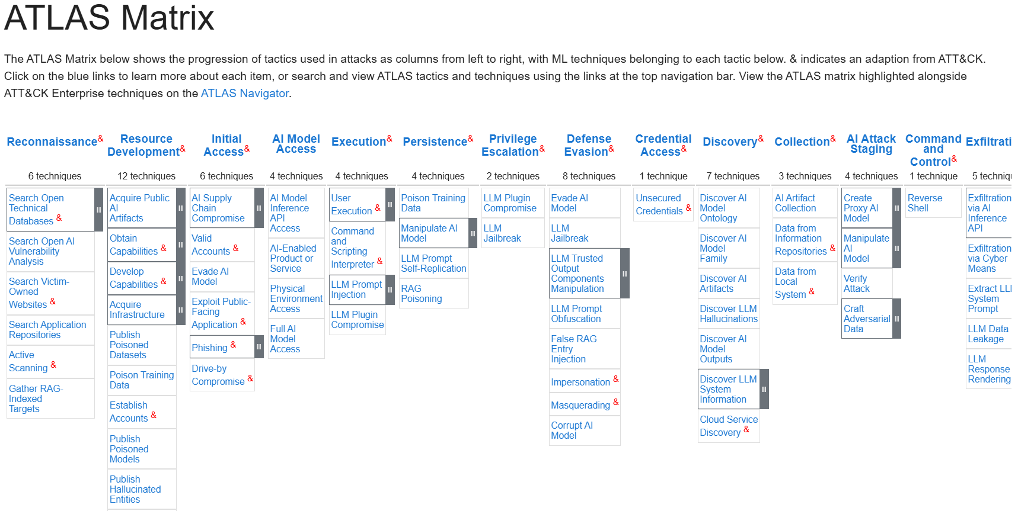
Investigate Adversarial Techniques
https://atlas.mitre.org/matrices/ATLAS

Slide 26
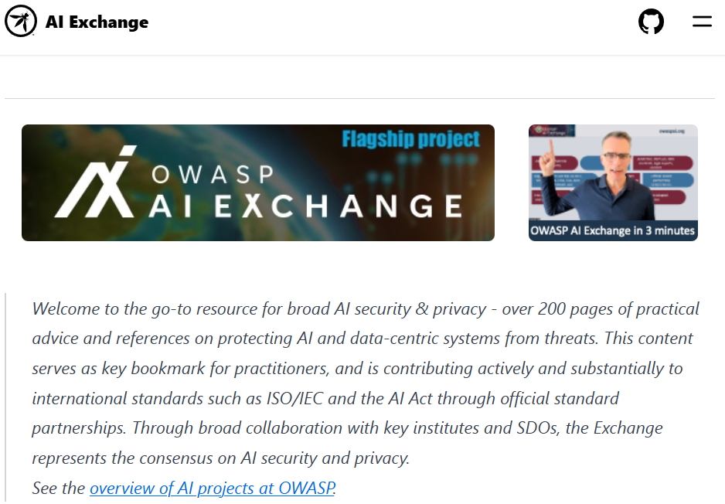
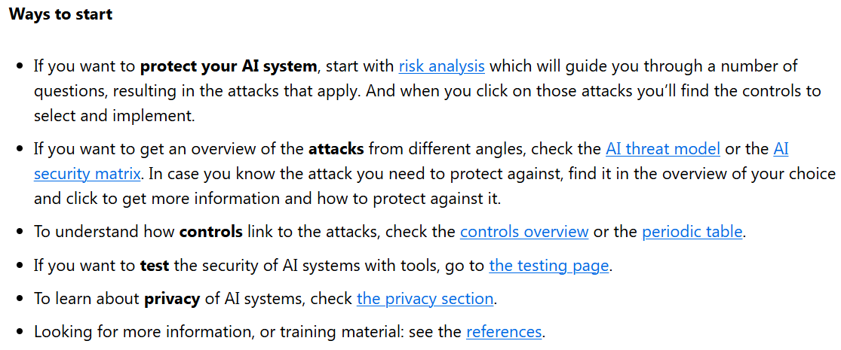
OWASP AI Projects
https://owaspai.org/

Slide 27
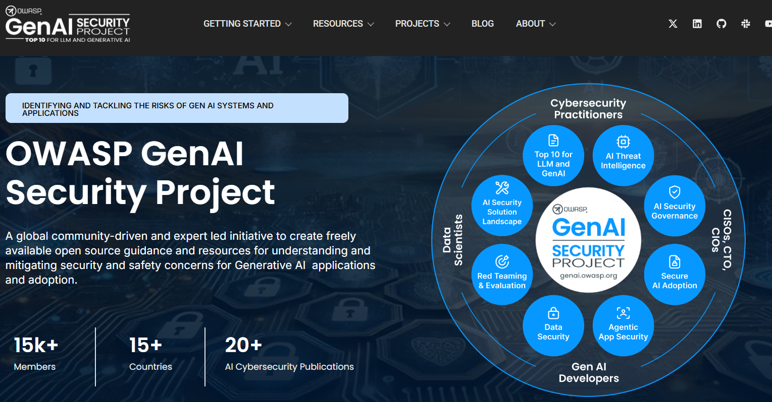
OWASP AI Projects
https://genai.owasp.org/

Slide 28
Beyond the Firewall: Evolving Cyber Skills for the Age of AI and Automation
For more, see:
Ron Woerner, CISSP, CISM
vCISO, Consultant, and Educator
Cyber AAA, LLC
https://www.linkedin.com/in/ronwoerner/
Slides are available at: https://github.com/hackerron/AI-Cybersecurity/blob/main/RWoerner%20-%20Evolving%20Cyber%20Skills%20-%20Sept2025.pdf

Slide 29
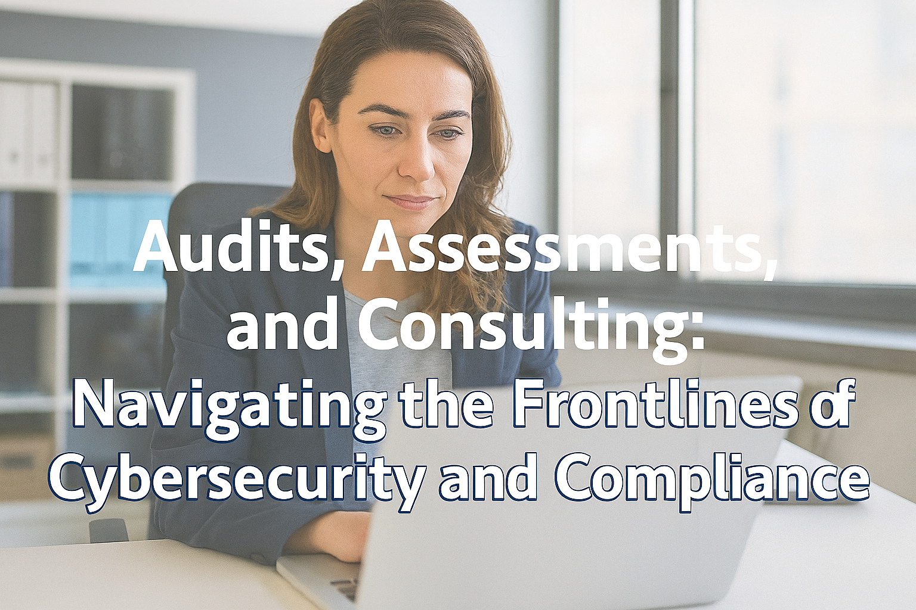
Life of an IT Auditor

Slide 30
Audit & Assessment Lifecycle
Plan
Scope
Execute
Report
Define objectives, stakeholders, and timelines
Deliver findings, risk ratings, and remediation guidance
Identify systems, data flows, and compliance boundaries
Perform testing, interviews, and evidence collection

Slide 31
Maturity Assessment & Growth Lifecycle
What are we looking at?
Confirm the current environ-ment
Baseline against the standard
Clarify/Set goals
Determine gaps
Analyze gaps for risk and priority
Establish the implement- ation plan
Monitor, review, and update
How do we continuously improve?
Where are we?
Assessing and analyzing capabilities to establish actionable improvements
How do we reach our goals?
Where do we want to be?
What’s most important and why?
What’s the diff btwn baseline & goals?

Slide 32
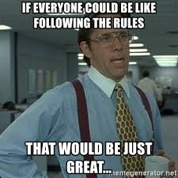

What’s the Difference Betweek Audit & Cybersecurity?

Slide 33
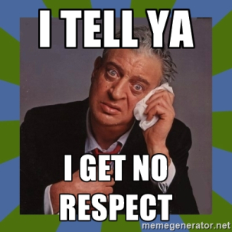
Eugene Spafford’s first principal of security administration:
If you have responsibility for security, but have no authority to set rules or punish violators, your role is to take the blame when something goes wrong.*
* Garfinkle & Spafford, Practical Unix & Internet Security, O’Reilly & Associates, Inc, 1996, p.39.

Slide 34
Talking over people’s heads
“I have a couple employees who specialize in payment fraud who are wanting to get more involved with SecOps, which I’m finding communication avenues to be a challenging issue to overcome. When I explain basics, I have a habit of looking at basics as basic, and lose the fact that my basic is complicated for others.”

Slide 35

Sucking at Cybersecurity / IT Audit
Groundhog Day
Influence / Communications
Wrong Focus
NO-it-alls
Stress

Slide 36
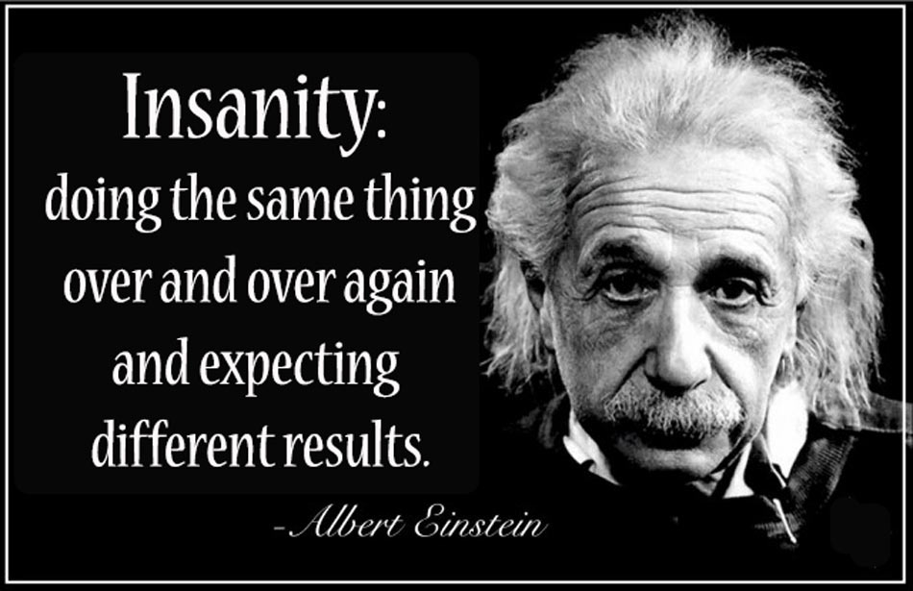

Slide 37
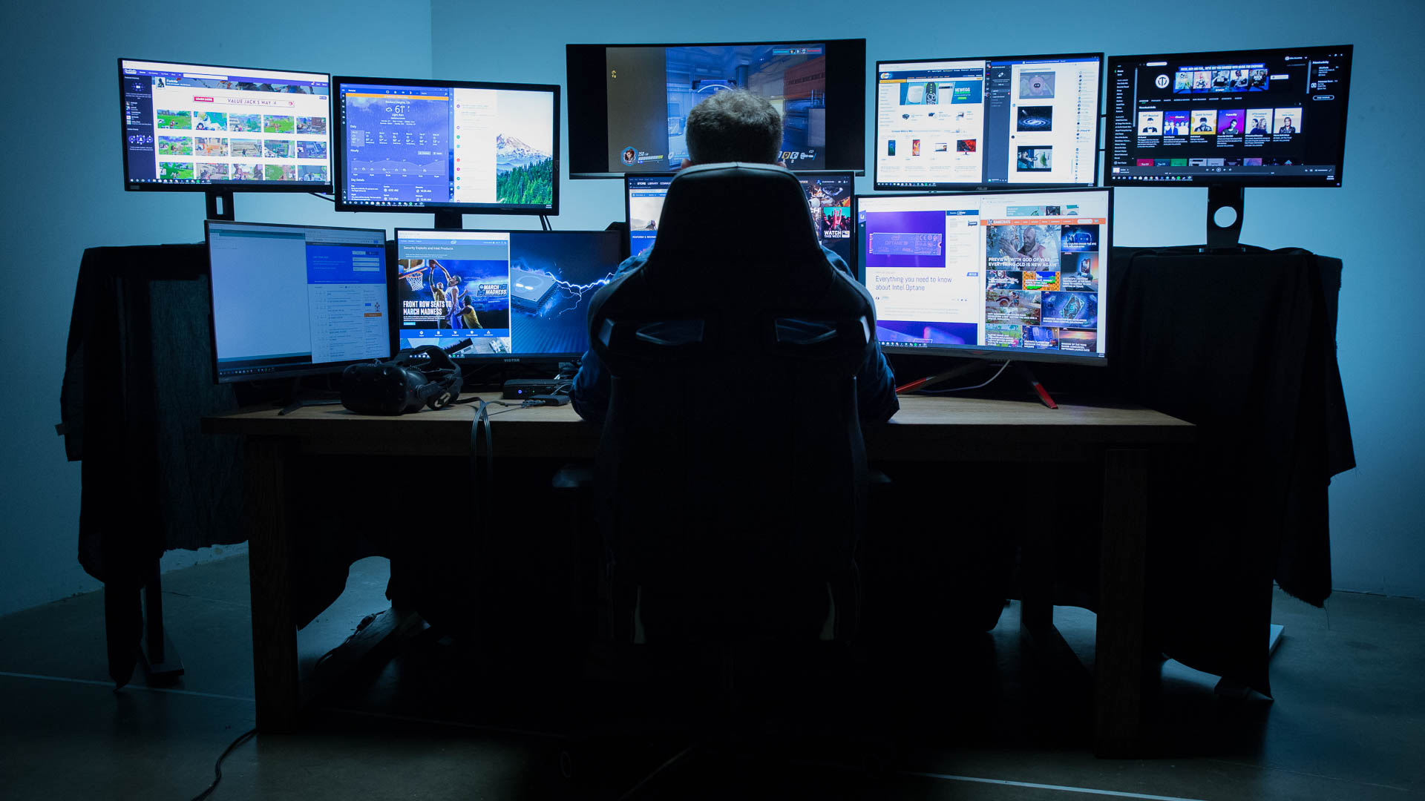
NOT Sucking at Cybersecurity / IT Audit
Start with “Why?”
Do your homework
ABC = Always Be Curious
CYA = Challenge Your Assumptions
Know Your Audience
Talk Business Talk
It’s All About Risk and risk is about economics

Slide 38

You can’t (and shouldn’t try to) fix everything.
Who Owns the Headache?
Prioritizing risks vs costs
Look for treasures
Power of the pen

Slide 39
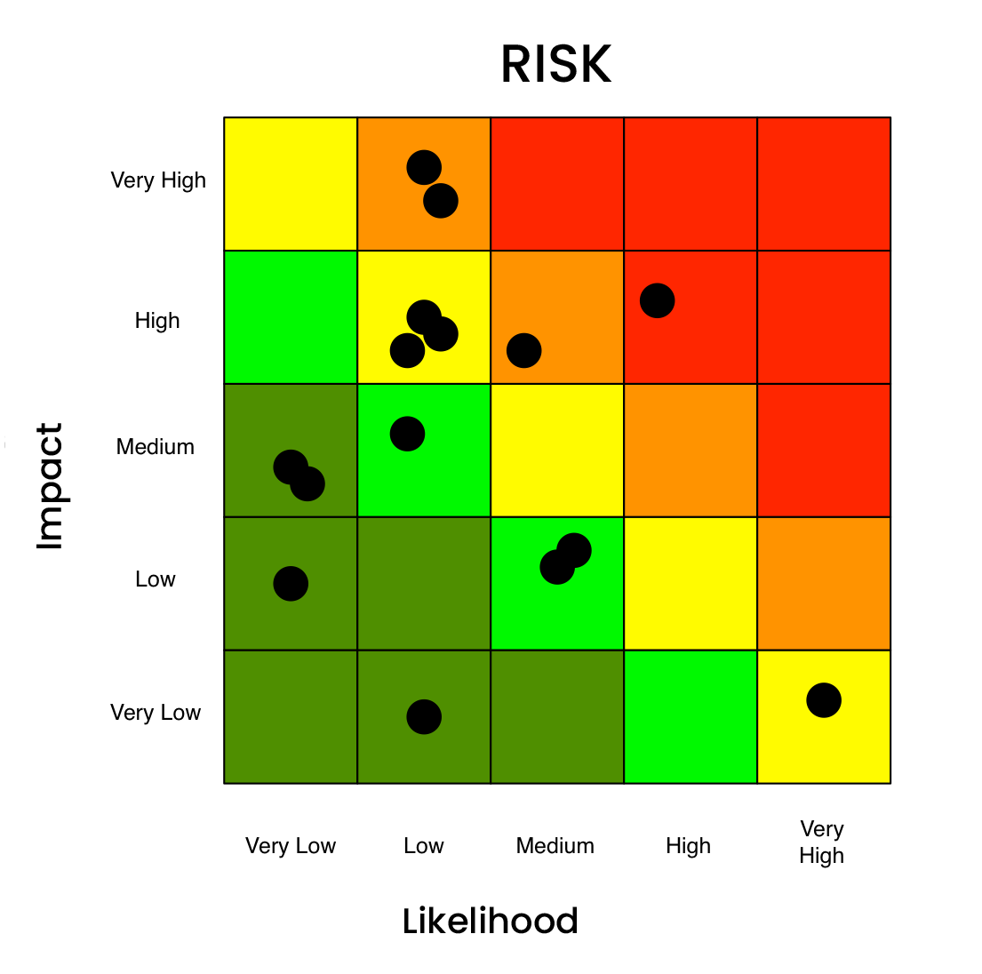

Balancing Risk
Qualitative
Low, Medium, High
Subjective
Quantitative
Frequency of occurrence
Loss event probability
Impact costs ($, time, resources)

Slide 40

Homework
Cambridge Ideas - Professor Risk
https://youtu.be/a1PtQ67urG4?si=QdKHr-jnORqebQrF

Slide 41

Working together
People
Notes:
Treasure map – agreement on assessment items between security, audit and IT.

Slide 42

Power of Observation

Slide 43
Next Steps / “Apply” Slide – Summary
Immediate (the next week):
Review 2-3 resources from this presentation
Investigate and experiment with AI
Set a calendar reminder for 1 month…
Long-term (the next 1-2 months):
Review the deck and experiment with 2-3 new resources
Share with others
Lead with curiosity, defend with wisdom

Slide 44

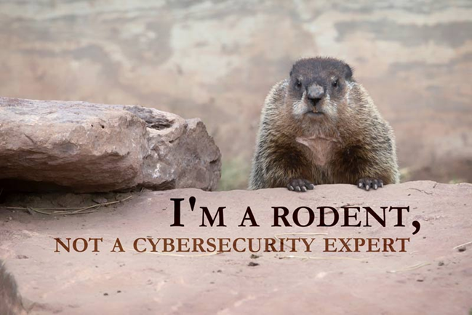
Thank You!
For More Information:
ronw@cyber-aaa.com
https://www.linkedin.com/in/ronwoerner/
https://linktr.ee/cyberron

